Slide 1
Blank Slide
This slide is intentionally left blank
Notes:
These are notes to ensure that I can see the notes!

Slide 2
Paul Michaels
Book:
C#8 and .Net Core 3 Blueprints
My Blog:
https://www.pmichaels.net/
This talk:
https://github.com/pcmichaels/WindowsDesktopTalk
@paul_michaels
LinkedIn: https://www.linkedin.com/in/pcmichaels/
E-mail: pcmichaels@live.com
Notes:
Talk about how I started
Spectrum ‘83/84 48K Spectrum ZX.
Display of hands: Anyone owned a spectrum? Anyone programmed on a spectrum? Anyone heard of functions in Spectrum Basic?
1997 – professional programmer - Pascal

Slide 3
The Future of the Windows Desktop
Using .Net Core 3 Features to Improve Desktop Applications

Slide 4
Why?
Haven’t we all agreed on the web?
Notes:
This talk is about running desktop applications on .Net Core 3. Why would we want to do that?
Did we decide on the web – and if so, why did we decide on the web? Security and Deployability?
Would you create a new desktop application?
Do you have existing desktop applications?
Next slide - legacy

Slide 5
Legacy / Upgrade
WinForms
Upgrade path – migrate to .Net Core 3
Xaml Islands
WCF -> GRPC
Or upgrade to and leave on 4.8 (if it ain’t broke…)
WPF
Move to Xamarin / UWP
Upgrade to .Net Core 3
Xaml Islands
WCF -> GRPC
Move to / Leave on 4.8
UWP?
What about UWP?
Move to 1903 or later
Notes:
Do you have legacy apps. If so, what are your options?
You may have legacy apps running on earlier versions of the framework
Where does this leave UWP? UWP is still the MS choice for desktop.
Whilst you don’t need to upgrade to .Net Core 3 – doing so does now give you some advantages… which we’ll cover in this talk.

Slide 6
How Did We Get Here?
Desktop apps used to be the only game in town (concept of a web app had yet to be invented)
VB 5/6 and Access meant that the ability to create new apps was open to a whole new range of people
Internet connection became more prevalent and faster
The real catalyst was the smart phone – creating a web page meant that people could view your content on their phone
Notes:
Why is it the case that most programmers are now working on the web, and apps that are desperate to be desktop apps are show-horned into web frameworks? Talk about the audit app briefly – that would have been better as a desktop app

Slide 7
What has the web ever done for us?
Deploy apps – trivial on the web, but varying degrees of torture for the desktop
Working inside a sandbox – secure
Code (can be) on the server, so you don’t have worry about IP vulnerabilities
Most sites just work on a mobile form factor
150 new Javascript libraries every week!
Modern browsers, whatever you may think of them, are essentially the desktop part of the desktop app, but written by teams of experts over periods of years – can you do better?
Notes:
So, we got to the web, but is it that good? Why are we happy where we are?
Yes, but apart from …

Slide 8
Still a place for desktop?
NO client server traffic for updating a screen
Desktop apps are stateful by default
Scaleable (you should only make calls when you need to read from or write to the server)
With the caveat that deployment and upgrade may become more difficult
Total control over your environment
Arguably faster and easier to write (certainly WinForms)
No need for an internet connection
Games (MonoGame uses WinForms)
Rewrite your own WPF
Legacy – your apps are already there
Notes:
Selling the desktop
6. Talk about SPF
7. Legacy is the most compelling – don’t re-write winforms apps just because they are winforms

Slide 9
WinForms – Is it all that bad?
It really is
But…
.Net Framework
Try employing people to work on it!
Hard to write well
Platform Specific
Typically not very testable, and not very tested
Hard to deploy
Fast and easy to develop
Your apps may already be written and running
Users are used to it – everyone likes battleship grey!

Slide 10
Upgrading to .Net Core - Options
In place upgrade
Essentially just change the csproj file
Side by side upgrade
Same directory (.net core looks in the same directory by default)
Different directory, but link the files
Notes:
Supposed to be a bridge!

Slide 11
Preparation for an Upgrade to .Net Core
Convert Package References
Migrate the business logic away from the UI (get rid of code-behind files as much as possible)
Add tests – there are some Selenium-like tools for desktop
Notes:
Convert Package References – show the context menu option on Right Click on packages.config -> “migrate packages.config to…”
MVVM, MVP

Slide 12

Demo – Migrate WinForms to .Net Core
Notes:
Show GenerateLargeFiles
Helpers
Portability analyser
Steps to upgrade:
Create a new project in the same solution
Add existing files (see the compile include – compile include wildcard – can’t do a full wildcard, because it includes all the .Net Framework directories - properties, etc..)
Add NuGet packages
Speed! Around ¼ to 1/3 faster
Following slides are what we did in the demo

Slide 13
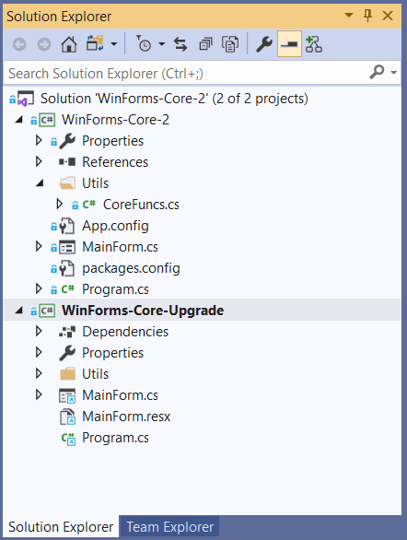
Create new Project
Notes:
You can upgrade in-situ – your choice

Slide 14
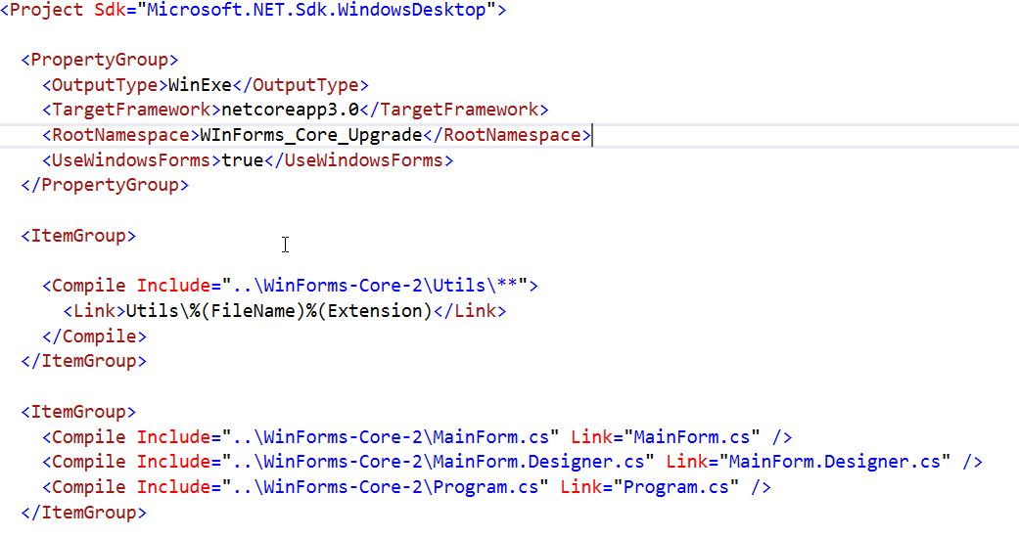
Add Existing Files
Notes:
You can also copy and paste

Slide 15
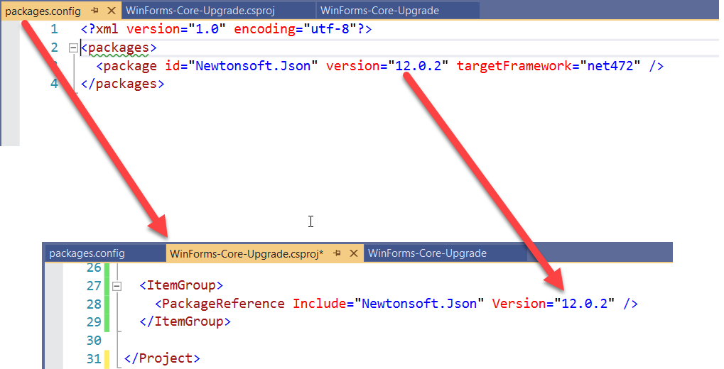
NuGet
Notes:
Packages.config -> csproj file

Slide 16
WinForms – Still all that bad?
.Net Framework
Try employing people to work on it!
Platform Specific
Typically not very testable, and not very tested
Hard to deploy
.Net Core 3
Still platform specific, but that’s probably what you want
If your app isn’t properly tested, this won’t help you!
Single exe and tree shaking!
Notes:
Answers in the animation
Arguably, this makes your code MORE platform specific – while .Net Core 3 MAY run on previous versions of Windows, UWP does not, and XAML Islands in 1903 minimum.

Slide 17

Demo – Single Exe and Tree Shaking
Notes:
Publish the app as is
Runtime identifier (includes the runtime by default)
SelfContained = false (back to default)
PublishSingleFile (note file size)
PubishTrimmed (note file size)

Slide 18
Tree Shaking, Compilation and Single Exe
PublishSingleFile (output as a single exe)
RuntimeIdentifier (target platform)
PublishReadyToRun (compiled – sort of – just faster)
PublishTrimmed (tree shaking)
SelfContained (include the runtime – defaults to true where the runtime identifier is set)

Slide 19
WPF – The Kiosk Application
WPF is cool isn’t it?
It was
Xaml (XML is the language that Json could have been!)
Similar to UWP and Xamarin Xaml
Xaml standards are supposed to be aligning… soon
Binding (features)
Testability (Compared to WinForms!)
MVVM
Can be (sort of) cross platform
INotifyPropertyChanged
Binding (complexity)
Resources
Deployment (ClickOnce)
Not exactly cutting edge technology!
Notes:
Every WPF App seems to be a kiosk application

Slide 20

(Very Quick) Demo – WPF to .Net Core 3
Notes:
Next slide is a video demo

Slide 21
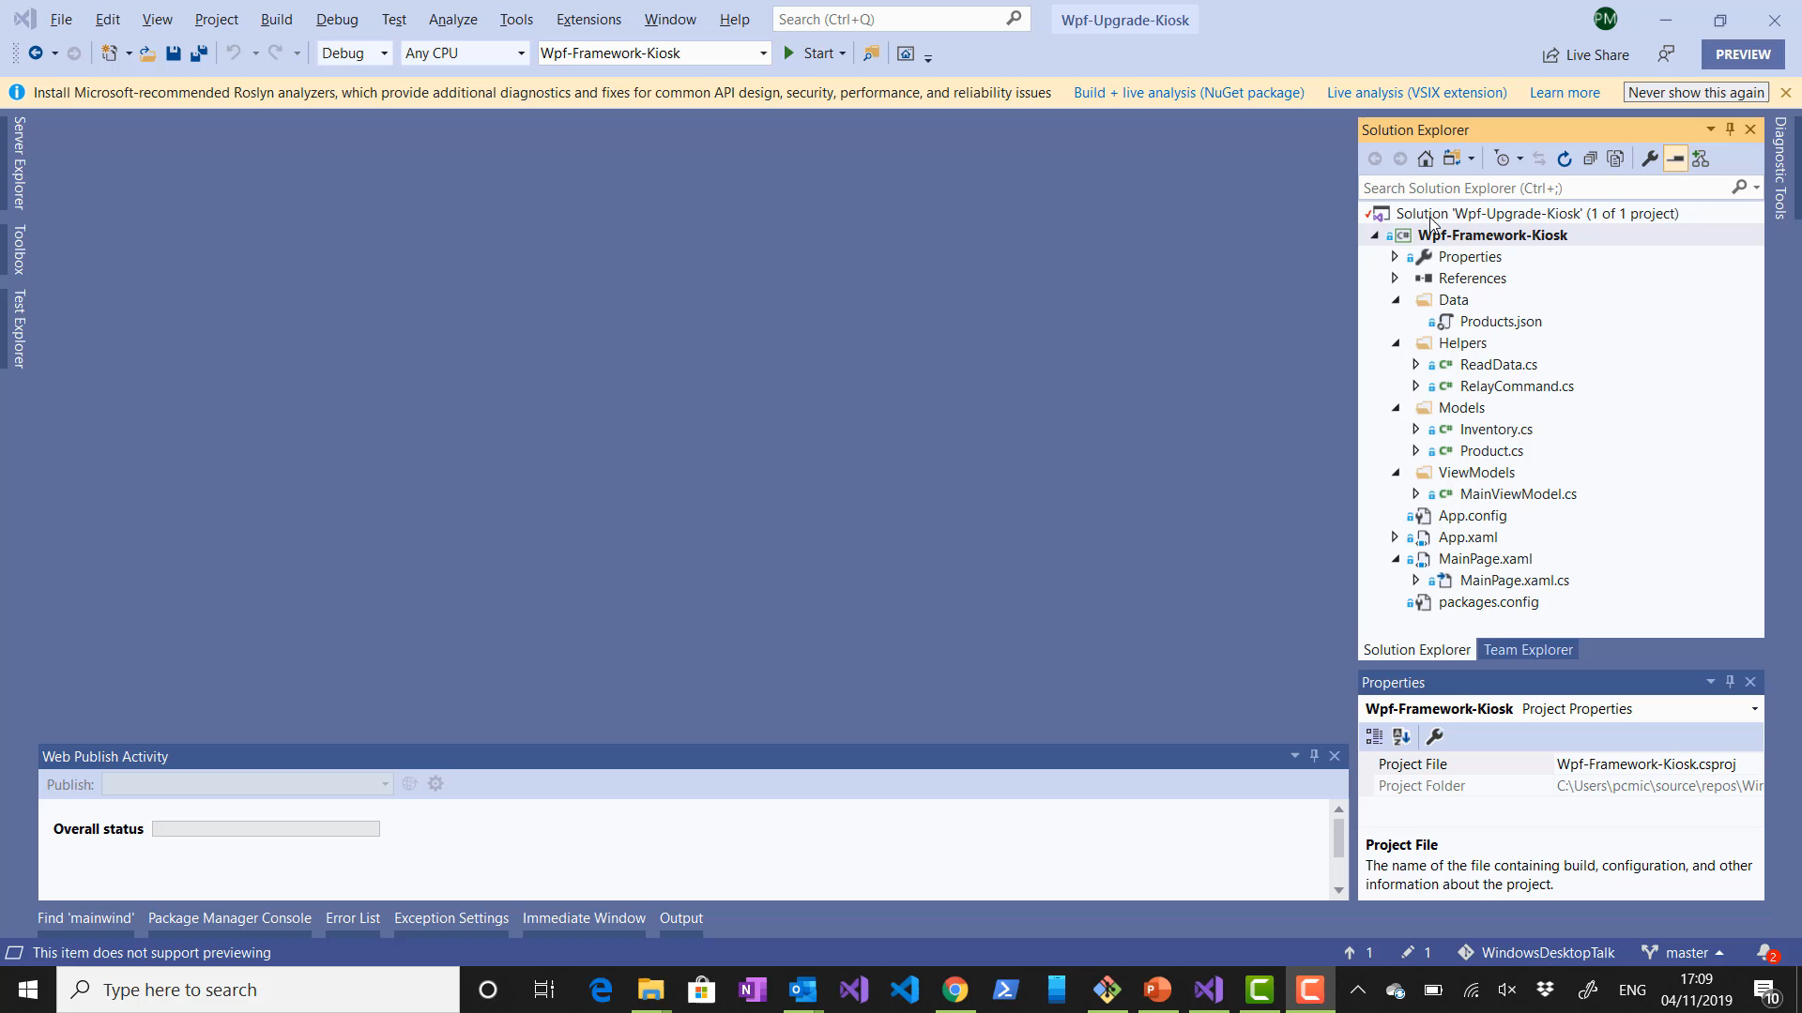
Notes:
Rather than watch me typing all this stuff – watch a video of me typing all this stuff!
At the end – who spotted the intentional omission? Didn’t show the .Net App Working, because it doesn’t.

Slide 22
Live Debugging Session

Slide 23
WPF – Still tech from 2006?
INotifyPropertyChanged
Binding (Complexity)
Resources
Deployment (ClickOnce)
Not Exactly Cutting Edge Technology!
If this was problem before, then it still is!
MSix
.Net Core 3

Slide 24
MSix
Works with any desktop app (WPF & Winforms) – doesn’t have to be .Net Core 3!
Only Windows 10
Need to Install UWP Workload
Publish to Store, Azure App Service, or locally
Notes:
Haven’t verified the WPF and WinForm thing

Slide 25
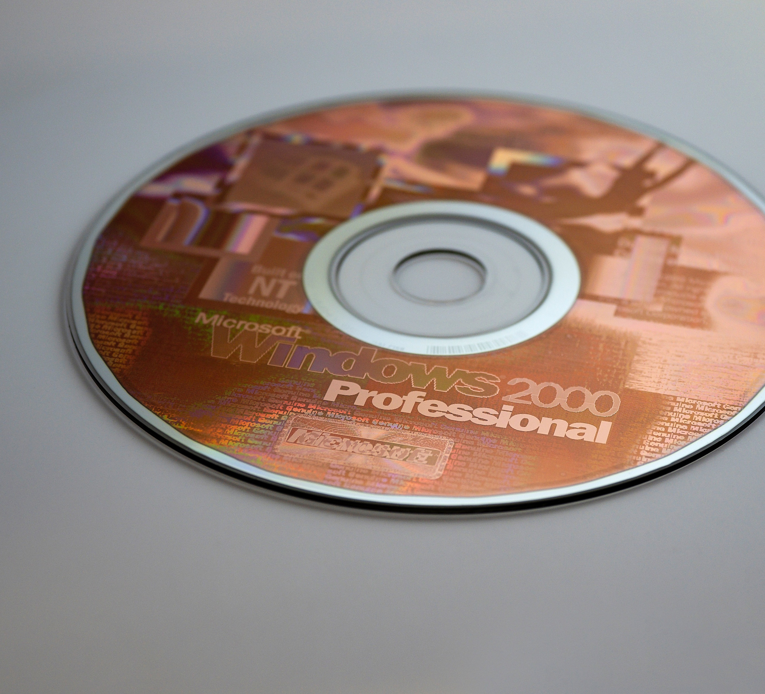
MSix Demo

Slide 26
Xaml Islands
Create Controls in UWP that can be used in WinForms or WPF
Starting from Windows 10 - 1903
WindowsXamlHost control for custom controls
WebView
Embed auth in winforms and WPF apps
Custom Controls are still in preview

Slide 27

Demo - Xaml Islands
Notes:
Following slides cover creating custom UWP control library

Slide 28
Create Custom UWP Control
Create new project: Universal Windows
Disable EnableTypeInfoReflection and EnableXBindDiagnostics
Add the UWP Page
Create a WPF Application
Add the WindowsXamlHost
FLAKY! Currently works with hosting entire UWP page, but not user controls

Slide 29
What does this mean for the future of Desktop Development?
Take legacy apps and improve them from the outside in
The WinForms app that’s being running the nuclear reactor for the last 15 years can be upgraded without the risk of pulling it apart
WinForms and WPF apps can now be deployed to the Microsoft Store… which will promptly fill up with Kiosk apps!
XAML looks to be staying as the language of the desktop - .Net 5 is set to see this standardise
ClickOnce is dead – long live MSix !

Slide 30
Should I Create a New Desktop App?
There are still issues with desktop apps:
C# code is downloaded locally and so IP is exposed (true also for Blazor client)
MSix does solve some of the deployment issues, but now you’re in a sandbox
It’s still difficult to get people to work on the desktop
Desktop apps have their place:
Large amount of offline work
Intensive graphic manipulation
Complex UIs with state
Re-use existing code and apps
Notes:
Nothing fundamental has changed

Slide 31
If I do Create a new Desktop App, what should I use?
WinForms:
VERY fast to get simple functionality up and running
Still a VERY low barrier to entry
If you’re not using MVVM or binding, you might as well use WinForms
WPF:
Using XAML, so if you’re using XAML, you should probably be creating a UWP app
Do you really need the very specific complex binding or animations that aren’t available in UWP?
UWP:
Seems to be the MS recommendation (although VS Code is written in Electron!)
Supports MOST of the WPF XAML in one way or another (multi-binding, triggers, etc. not supported still)

Slide 32
The Windows Desktop Alternatives
Electron (VS Code – picks up where WinJS left off, but cross platform)
Blazor – Client Side
Xamarin
Flutter (Google – using Dart)
Roll your own
Notes:
Roll your own - monogame

Slide 33
Summary
Windows Desktop is NOT dead
Surprisingly, WinForms seems to be more viable than WPF now
Web development is still far more prevalent
There’s probably no desktop revival anytime soon – but there are technologies that may step into that gap (Blazor for example)
There are certain things that just can’t be a web app (games, complex LOB apps, apps that need to interface with hardware)
As C# becomes more and more pervasive, people may return to some of these desktop technologies
Having said all that, I probably won’t be adding WinForms back onto my CV anytime soon!

Slide 34
Questions

